Slide 1
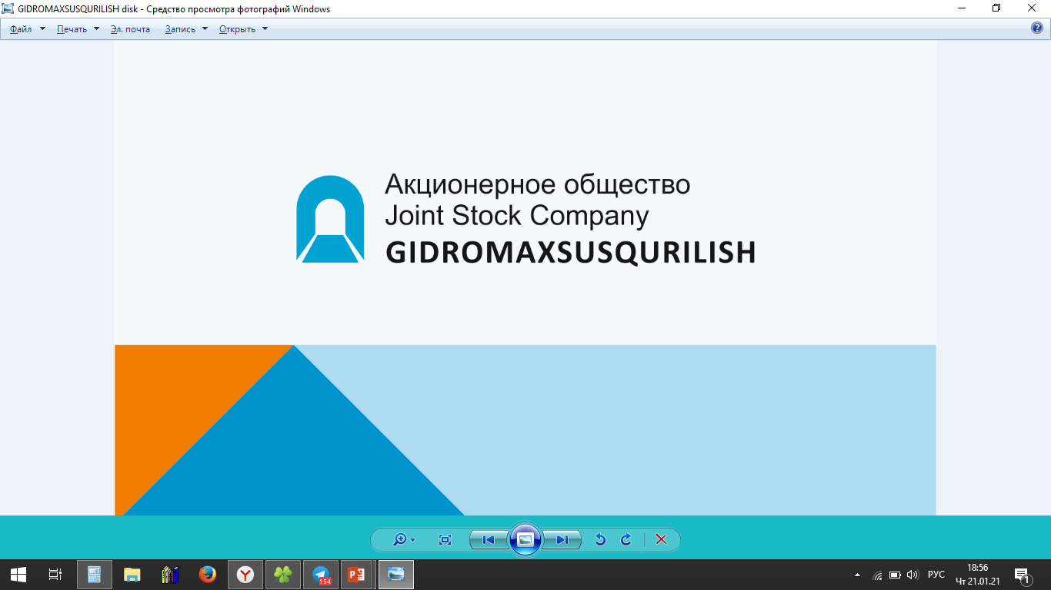
«gidromaxsusqurilish»
CONSTRUCTION AND CONTRACTING ORGANIZATION JOINT STOCK COMPANY

Slide 2
THE HISTORY OF THE ORGANIZATION
The Uzbek specialized enterprise “Gidmaxsusqurilish” was created on the basis of the Order of the Ministry of Energy of the former USSR dated back January 24, 1961 No.14 and was directly subordinate to the All-Union Trust “Gidmaxsusqurilish” of the Ministry of Energy;
Based on the Resolution of the Cabinet of Ministers of the RUZ on measures to organize the activities of the State Joint Company “Uzbekenergo”№ 93 from February 24, 2001.The Uzbek specialized department “Gidmaxsusqurilish” entered the system of SJSC “Uzbekenergo”;
Open joint Stock Company “Gidmaxsusqurilish” was created on the basis of the Order of the State Property Committee of the Republic of Uzbekistan dated March 31, 2004. No.41 “ On the transformation of the Uzbek special department ”Gidmaxsusqurilish” into an Open Joint Stock Company and is structural subdivision of SJSC Uzbekenergo ( order for SJSC Uzbekenergo dated back July, No.152), later renamed into Joint-stock Company (06.08.2014 No.000465-04);
Based on the Decree of the President of the Republic of Uzbekistan UP-5044 dated 05/18/2017., Resolution of the President of the Republic of Uzbekistan PP-2947 from 05/02/2017., Decree of the President of the Republic of Uzbekistan PP-2972 dated 05/18/2017, became part of "Uzbekgidroenergo”;
Resolution of the Cabinet of Ministers of the PKM No. 407 dated June 22, 2017 on the transfer of the share of Uzbekenergo to Uzbekgidroenergo of 97.45% of the shareholding of “Gidmaxsusqurilish’ JSC.

Slide 3
Composition of JSC "Gidmaxsusqurilish"
Unitary enterprise “Tupalanggidmaxsusqurilish”
"Tashkent" mechanical base
"Charvak" mechanical base

Slide 4
Primary activity
Tunneling of any section and with any lining ;
Injection and cementation work: conjugating strengthening, areal and filling cementation, cementation of construction joints,elimination of voids under foundations;
Drilling wells of any diameter up to 300 m deep, installation of bored piles;
Organization of construction and assembly, start-up and operational and commissioning works;
Construction of hydraulic structures;
Construction of bridges;
Drilling and blasting work.

Slide 5
JSC "Gidmaxsusqurilish" in its activities has carried out construction and installation work in the following facilities
Charvak HPP;
Pachkamar reservoir ;
Gissarak reservoir;
Zaamin reservoir;
Chimkurgan reservoir;
Karatepa reservoir ;
Kattakurgan reservoir ;
Angren reservoir;
Tuyamuyun reservoir ;
Tupalang reservoir.

Slide 6
JSC "Gidmaxsusqurilish" took part in the construction
Cooling towers of New-Angren and Tashkent TPPs;
Yunusobod line of Tashkent metro;
Tunnels of the Kamchik-Rezak passes, A-373 Tashkent-Osh highway;
Exits to the Khandizin’s ore deposit;
Construction of large reinforced concrete structures for the water outlet of the Fergana reservoir;
Drilling and blasting and earthworks on the construction of the “Tashguzar-Baysun-Kumkurgan” railway. At present, the enterprise's team performs drilling and blasting operations and a complex of underground operations at the construction site of Pskem, Lower-Chatkal and Zarchob” Hydro Electric Stations.
Drilling and blasting and earthworks on the construction of high-voltage lines during the laying of the Akhangaran-Pungan-PRC gas pipeline.

Slide 7
The volume of construction and installation work according to the Business Plan of the company for 2021
№ п/п | Object name | The contractor name | Volume of CIW (billion. sum/million. USA dollar)
1 | Construction of Pskem HPP | LLC "Topalang HPD water construction" | 57,5 / 5,5
2 | Construction of Lower-Chatkal Hpp | LLC "Topalang HPD Holding" | 45,1 / 4,3
3 | Construction of small HPP | LLC "TO`PALANG HPD PLATINUM" | 46 / 4,4
4 | Drilling and blasting operations at the Shargun mine | “Shargunkumir“ JSC | 9,2 / 0,9
 | TOTAL |  | 157,8 / 15,1

Slide 8
Financial and economic indicators of JSC "Gidmaxsusqurilish"
BY TOTAL OF 2018 YEAR
Net proceeds– 62,1 billion. sum (or calculated 5,9 million. USA dollar)
The number of employees – 477 people
BY TOTAL OF 2019 YEAR
Net proceeds – 138,2 billion. Sum( or calculated 13,1 million USA dollar)
The number of employees– 740 people
BY TOTAL OF 2020 YEAR
Net proceeds – 142,14 billion. sum (or calculated 13,6 million USA dollar)
The number of employees – 965 people

Slide 9
Technical park of machinery, mechanisms and special equipment of JSC "Gidmaxsusqurilish"
№ | Vehicle name and mechanism | Brand | Year of issue | Num.
1 | Drilling rigs and hydraulics drilling carriage with 2 arrows | KAISHAN KG-930A | 2018-2020 | 3
 |  | НКР-10МВПА-1-000 | 2018-2020 | 9
 |  | Atlas Copco Boomer 282 | 2018 | 2
2 | Compressors | KAISHAN LGCY 15/13 | 2018-2020 | 3
 |  | AIRPOOL PR 32 | 2018 | 2
 |  | JF АМ100А | 2018 | 4
3 | Drilling pumps | NB-32 with el. engine 45kw | 2018 | 2
 |  | Zoomlion 80.12.112 RSD | 2018 | 1
 |  | ANB-22 | 2018-2020 | 6
4 | Stirrer mortar and mortar unit, earthenware laboratories | NSA solution unit | 2018-2020 | 2
 |  | Clay labarotory | 2018-2020 | 2
 |  | RM-2000 | 2018 | 7
 |  | RM-750 with el.motor 5.5 |  | 2
5 | Diesel Generators | К4100 495 | 2019 | 1
 |  | ARNPOWER | 2020 | 2
6 | Forklift trucks | SHANTUI SL50W-2 | 2018 | 3
 |  | XCMG ZL50GN | 2019 | 2
 |  | SINOSTEEL CY-2 |  | 1
7 | Mini crawler tractors | ТY-3000 | 2018 | 4
8 | Excavators | SANY415 | 2019 | 1
 |  | Hyundai | 2018 | 1
9 | Mine fans | SVM-6 22kw 3000 | 2019 | 2
 |  | SVO-6 22 kW | 2019 | 2
10 | Welding machines, transformers and rectifiers | Conitech 630А | 2018-2020 | 4
 |  | WDM 6301 |  | 8
 |  | ВХ1 630 |  | 6
11 | Receiver | 10m3 | 2018 | 2
12 | Cement sprayer concrete shotcrete machine jets | TUNNEL-MAX | 2018 | 2
13 | Dump trucks | КАМАЗ-6520-1043 | 2018 | 3
 |  | SHACMAN - SX3318DT367 | 2019 | 4
14 | Concrete mixer trucks | КАМАЗ 53229-1933-15 | 2019 | 2
15 | Delivery vans | КАМАЗ-65115 | 2019 | 2
 |  | MAN CLA 16.230 4х2 ВВ | 2018 | 1
16 | Special equipment and semi-trailers | DOОNGFEND DFL 4251LAX8 | 2018-2020 | 2
 |  | HONDA XHD 9400TJZ |  | 1
 |  | MAZ (URB) |  | 2
17 | Truck cranes | МАN CLA 18.280 4/2ВВ | 2018-2020 | 2
 |  | Maz-5334 SMK-10 |  | 2
18 | Passenger cars and off-road vehicles | LACETTI | 2018 | 2
 |  | УАЗ-315195 |  | 5
 |  | LADA-21310 | 2019 | 3
 |  | LADA-21214-007-52 | 2020 | 3
 | Total |  |  | 120

Slide 10
Currently, the number of specialists of JSC "Gidromaxsusqurilish"
The number of employees– 965 people from them:
Cementation section (engineering and technical staff 80 people, working cementiters 245 people.)
Drilling and blasting section (engineers and technicians 29 people, workers drillers and explosives 90 people.)
The section of underground works (engineering and technical personnel 55 people, working sinkers 276 people
Site for a hydraulic structure (engineers and technicians 51 people, construction workers 139) and others

Slide 11
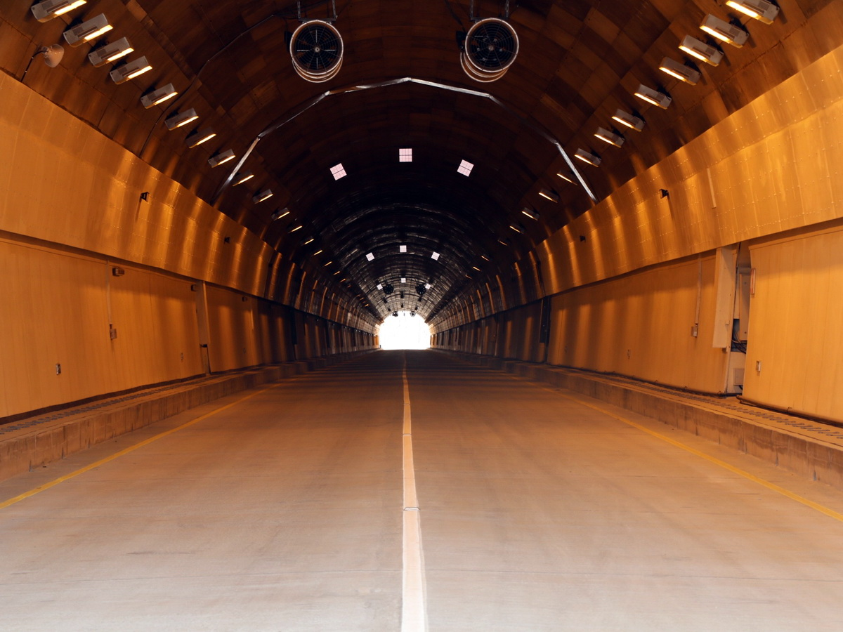
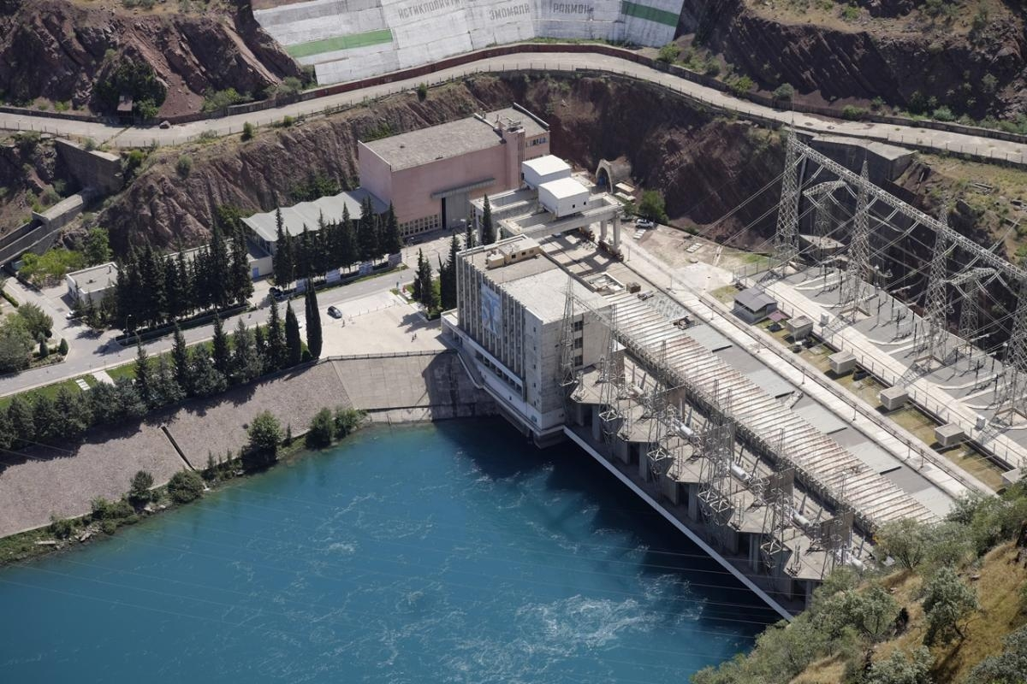
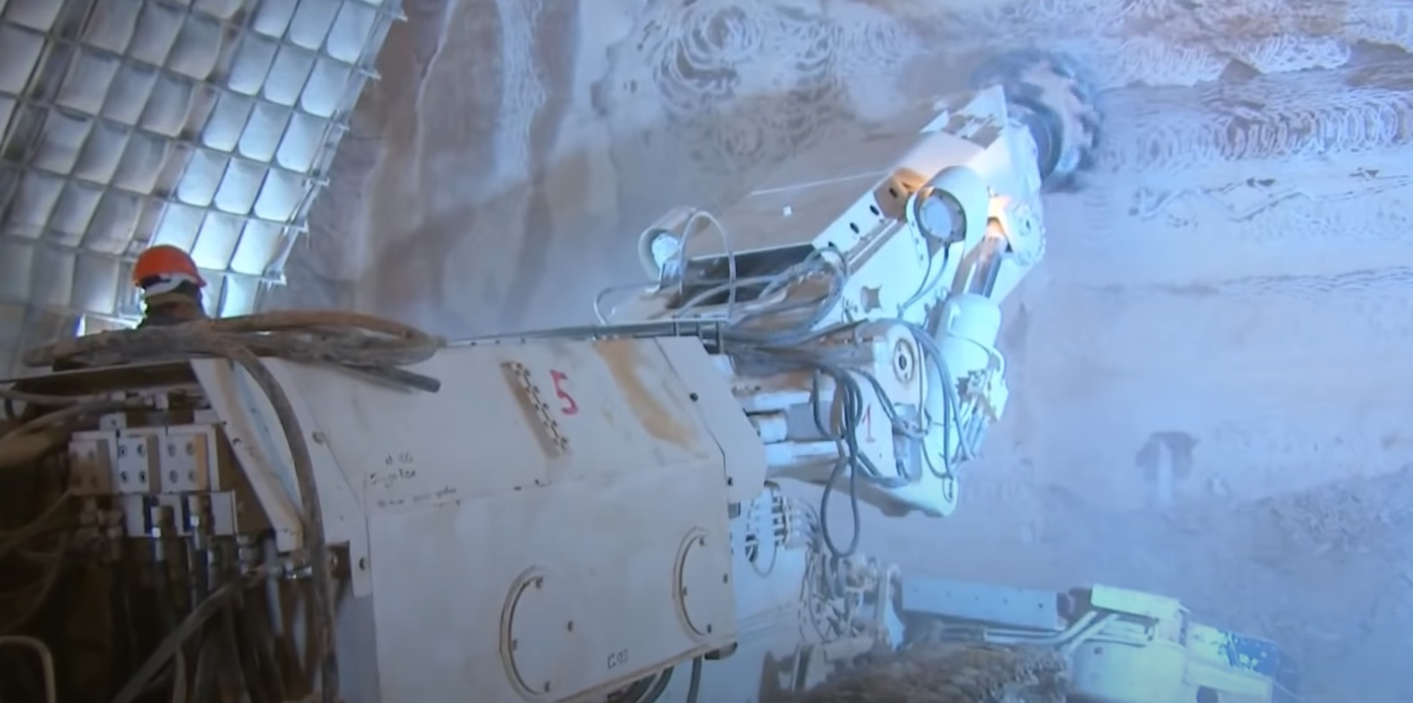
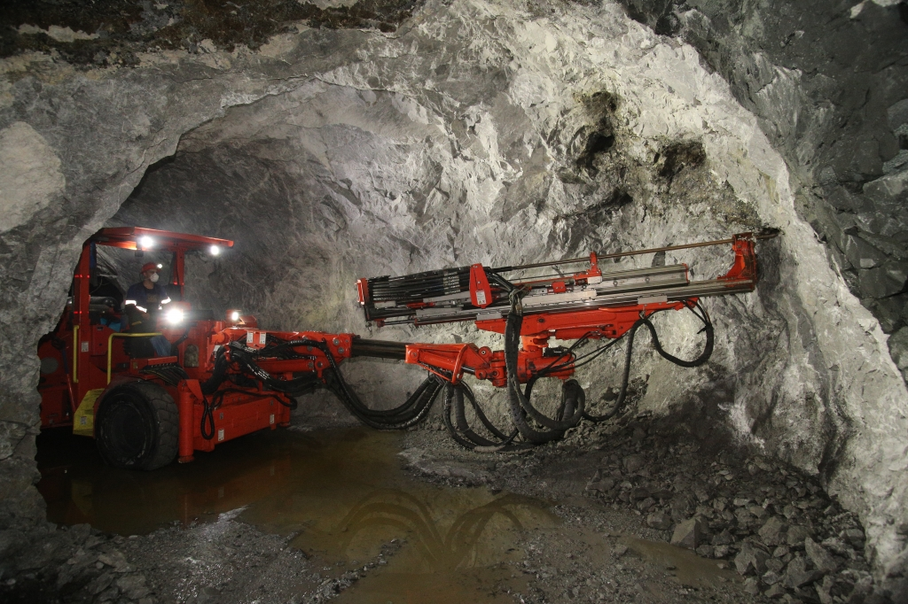
PHOTO GALLERY
Tunnels of the Kamchik-Rezak passes, A-373 Tashkent-Osh highway
Improving safety and functioning of the "Charvak HPP"
Driving by a combine harvester of the construction and operational Spillway Bottom No. 5
Driving ramps at “Khandizin” ore deposit

Slide 12
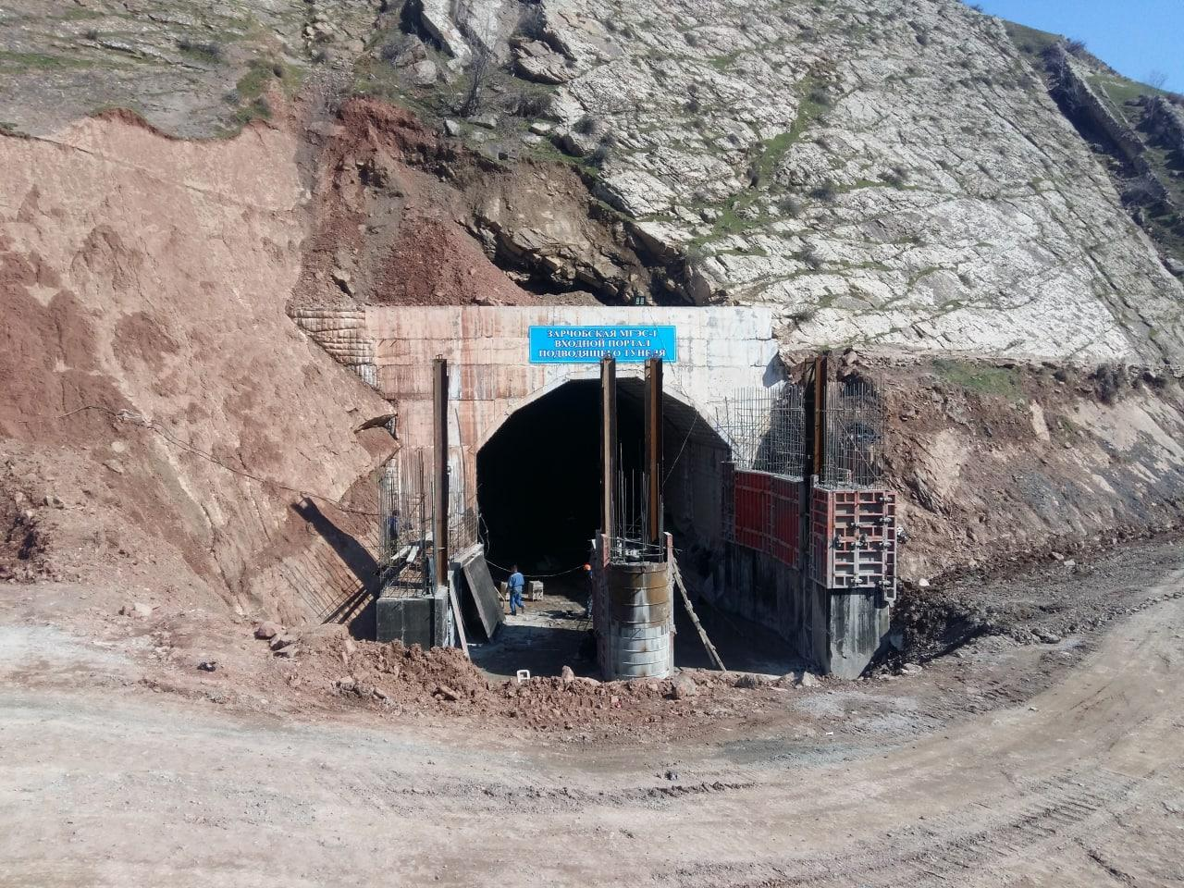
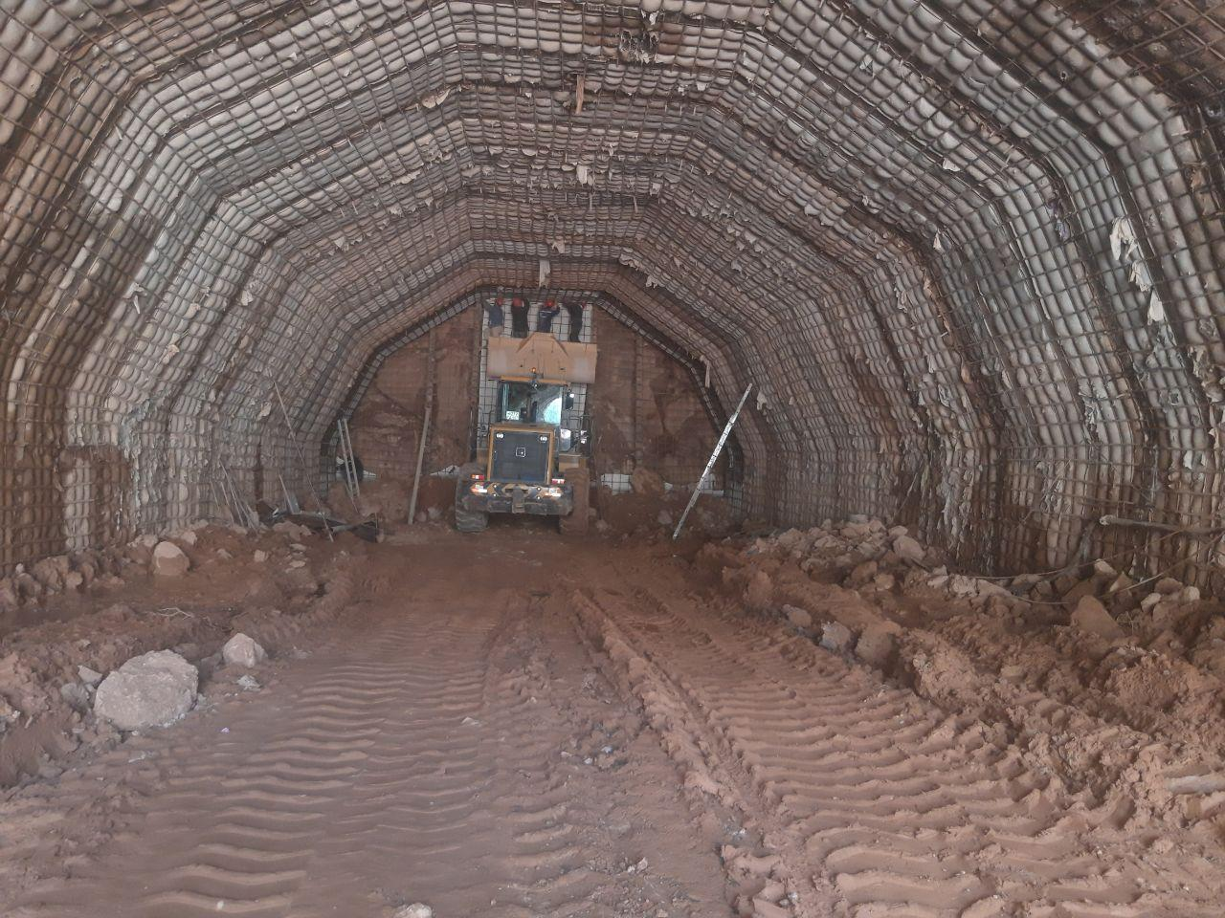
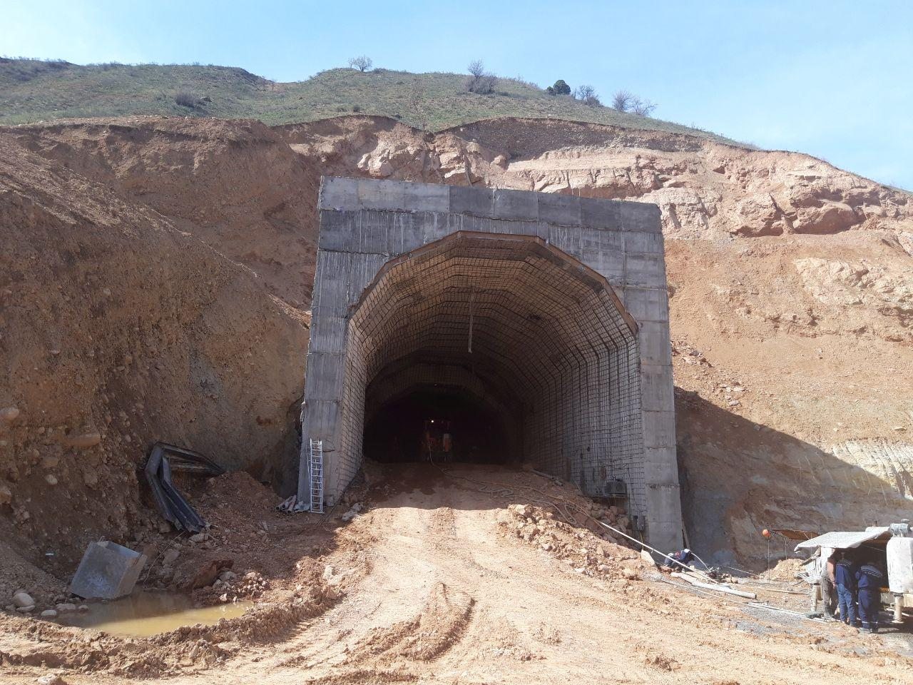
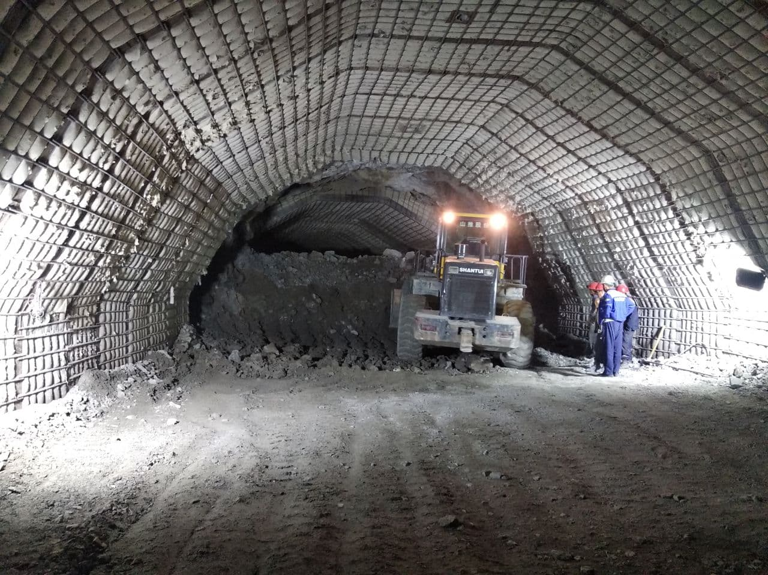
Entrance portal "Zarchob SHPP"
Driving the construction and operational sludge at the “Lower-Chatkal HPP"
Entrance portal of the energy and discharge tract of the construction operational spillway 2-tier "Pskem HPP"
Failure of the construction and operational spillway at PK1 + 74.20

Slide 13
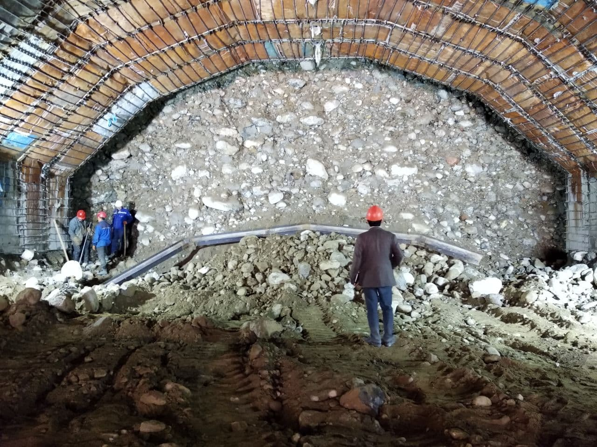
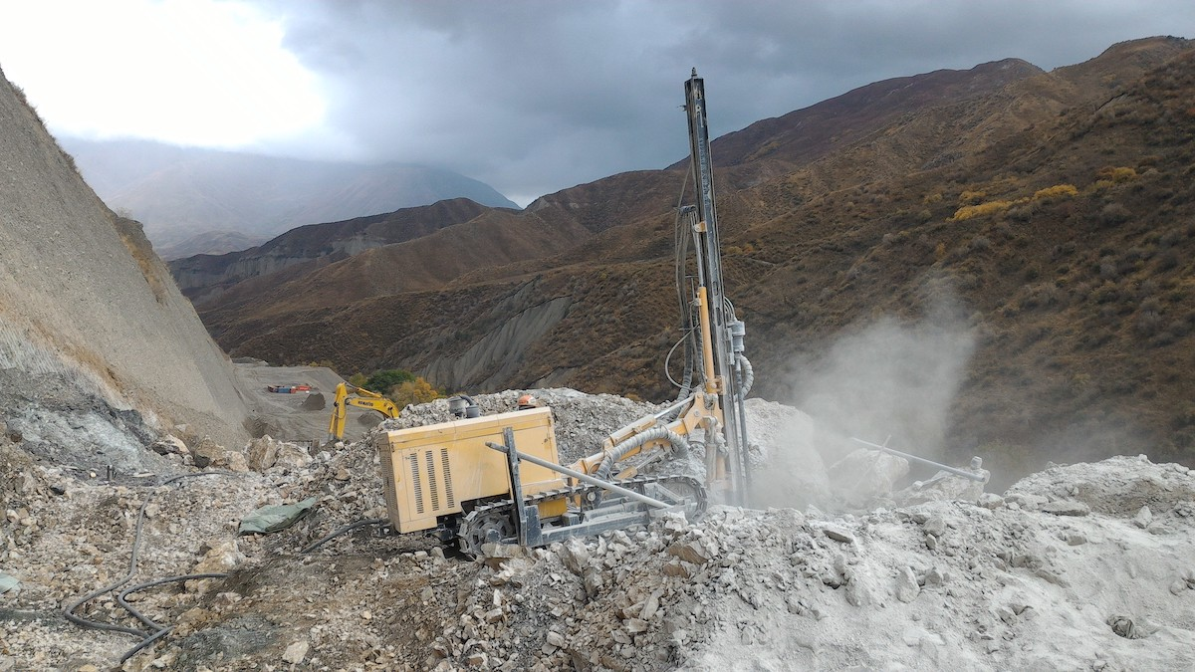
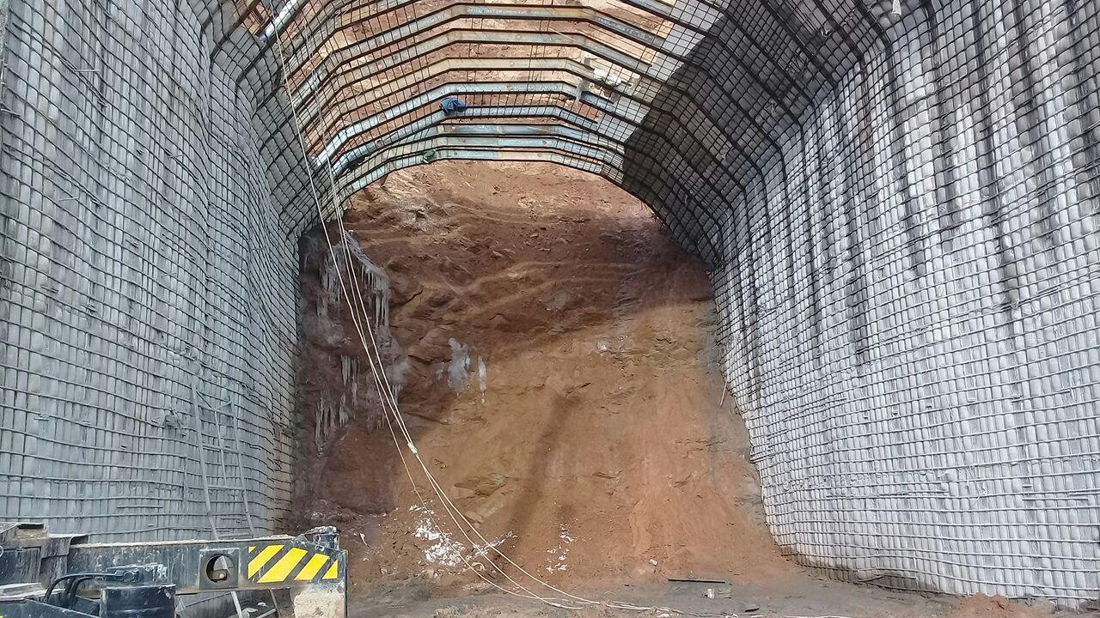
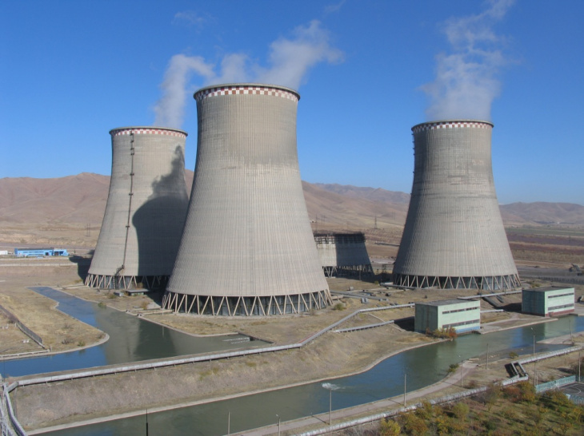
Tunneling the gate chamber of the “Lower-Chatkal HPP”
Drilling at the section of the road to the Pskem HPP quarry
Concreting of the entrance portal of the construction and operational spillway 2 tier
Cooling room at “New-Angren heat power plant”

Slide 14
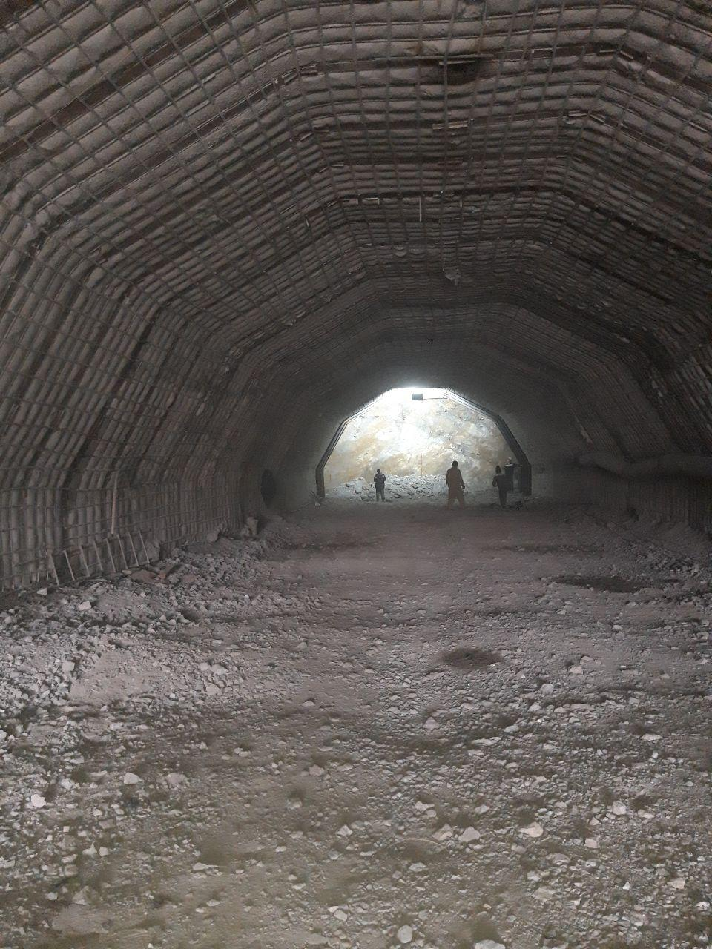
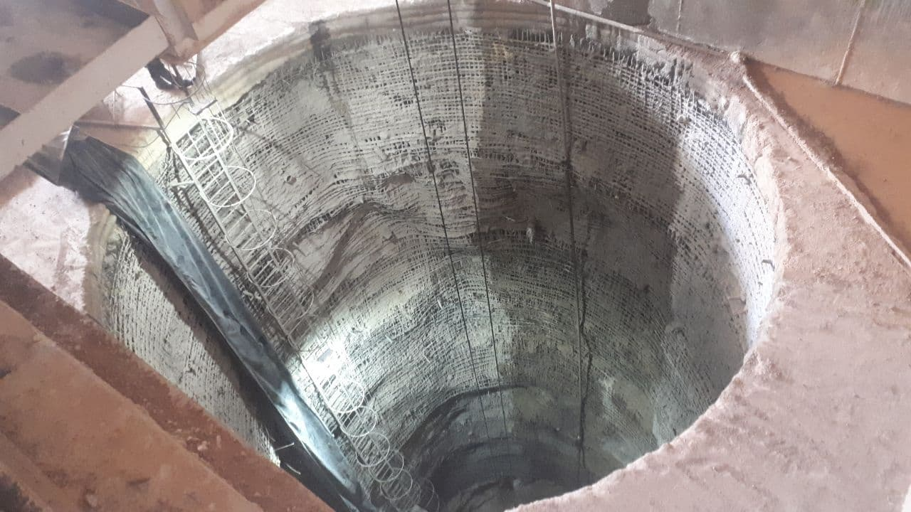
Tunneling at the “Lower-Chatkal HPP”
Driving a vertical mine at “Pskem HPP”

Slide 15
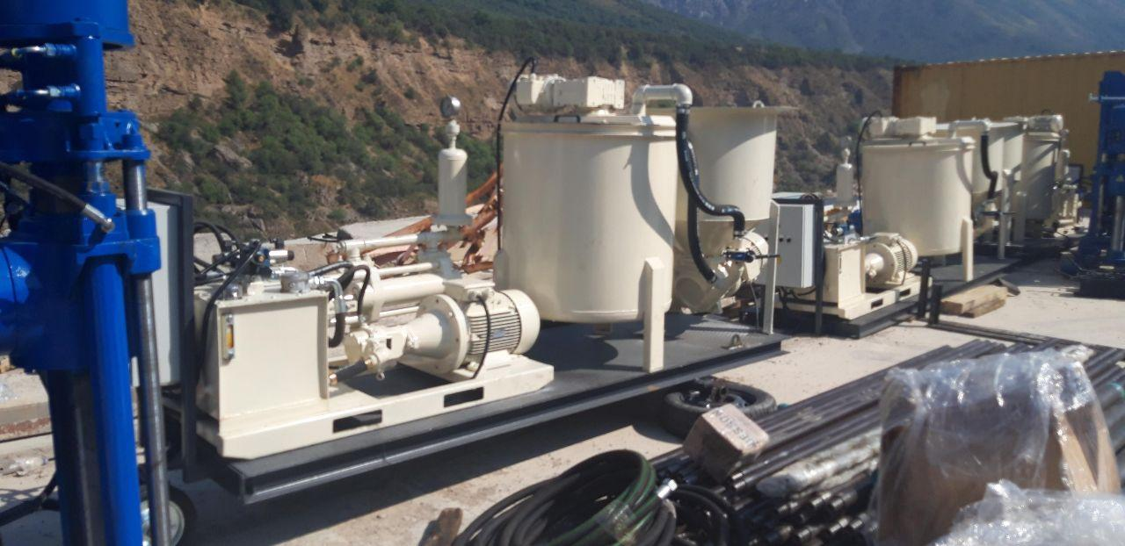
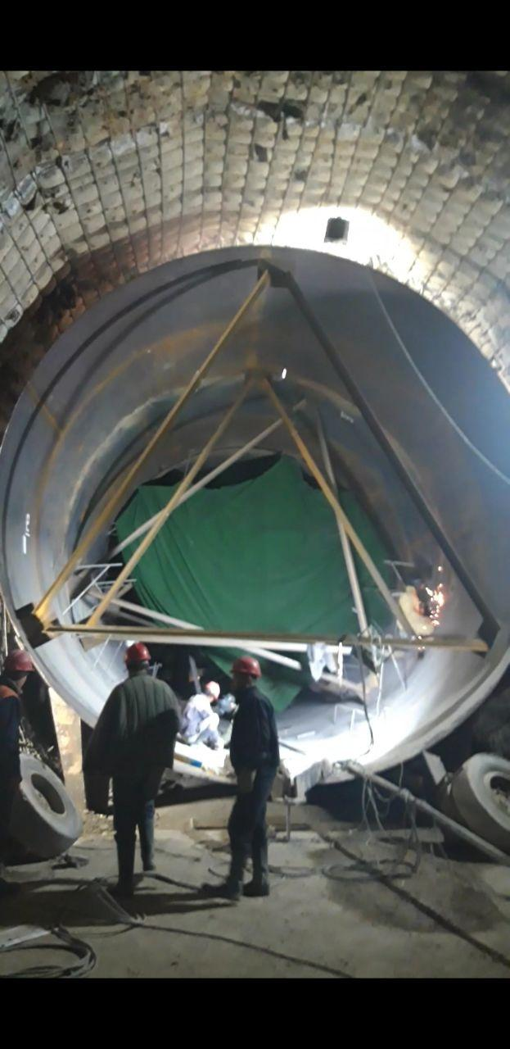
Cementation equipment
  Installation of metal cladding D = 6.5 m

Slide 16
Thanks for your attention

